Slide 1
Games Bootcamp
Intro to Game Dev

Slide 2

Meet The Team

Slide 3
Table of contents
01
Bootcamp Objectives
04
Game Design
02
State of Games
05
Major Project
03
Game Development
06
Resources
What to expect
Elements of Game Design
Game Industry Insights
Introduction to your project
Fundamentals
You can describe the topic of the section here

Slide 4
Bootcamp Objectives
Unity Engine
Game Dev
Game Jobs
Comprehensive overview of the Unity Game Engine
Learn the fundamentals of Game Development and Game Design
Industry insights and preparations

Slide 5
Timetable
Time | Content
11:30 - 12:55: | Topic 1 - Slides
13:00 - 14:20: | Topic 1 - Practical
14:20 - 14:40: | --BREAK–
14:40 - 15:55: | Topic 2 - Slides
16:00 - 17:30: | Topic 2 - Practical

Slide 6
Icebreaker
WORST GAME OF ALL TIME?
DO YOU PLAY AN INSTRUMENT?
BEST GAME OF ALL TIMES
DREAM JOB TITLE
FIRST CONSOLE YOU HAD

Slide 7
02
State of Games
Past, Present & Beyond

Slide 8
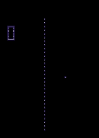
Pong (1972)
First commercial video game
Developed by Atari
Game ran on only 2KB
Notes:
Pong (1972):
The first widely popular arcade video game, representing a simple tennis-like game.
Space Invaders (1978):
Introduced new gameplay mechanics and was one of the earliest shooting games.
Pac-Man (1980):
Became a cultural icon and introduced new maze-chase gameplay.
Nintendo Entertainment System (NES) Release (1983):
Revitalized the crashed video game market with its release and iconic games like "Super Mario Bros."
The Legend of Zelda (1986):
Introduced a new level of depth and complexity to video games with its intricate worlds and puzzles.
Sega Genesis vs. Super Nintendo (late 1980s - early 1990s):
Marked a significant console war, pushing technological and marketing innovations.
Sony PlayStation Release (1994):
Brought 3D graphics to the forefront and marked the entry of CD-ROMs in gaming.
3D Graphics and Open Worlds (late 1990s - early 2000s):
Games like "The Elder Scrolls III: Morrowind" and "Grand Theft Auto III" introduced rich 3D open worlds.
Online Gaming and Multiplayer (2000s):
With games like "World of Warcraft" and platforms like Xbox Live, online multiplayer gaming became a significant trend.
Mobile Gaming Surge (2010s):
The rise of smartphones led to a boom in mobile gaming, with hits like "Angry Birds" and "Candy Crush."
Virtual Reality (2010s - Present):
The development and release of VR headsets like Oculus Rift brought immersive VR gaming to consumers.
Streaming and Cloud Gaming (2018 - Present):
Platforms like Google Stadia and NVIDIA GeForce Now introduced cloud gaming, while Twitch streaming became a cultural phenomenon.
Esports Explosion (2010s - Present):
Competitive gaming, or Esports, became a massive industry, with games like "League of Legends" and "Overwatch" at the forefront.
Battle Royale Craze (2010s - Present):
Games like "Fortnite" and "PUBG" popularized the Battle Royale genre, attracting millions of players worldwide.
Cross-Platform Play and Game Services (2019 - Present):
The introduction of cross-platform play and subscription services like Xbox Game Pass altered how games are played and accessed.
Ray Tracing and Next-Gen Consoles (2020 - Present):
The release of PlayStation 5 and Xbox Series X/S brought new technological advancements like ray tracing to a wider audience.

Slide 9
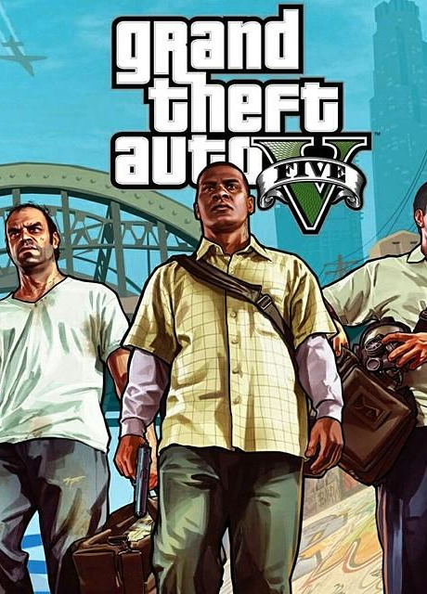
GTA V (2013)
Rockstar Games
$265M to Develop and publish
$8.3B Revenue since release
$800M yearly from shark cards
Released on 7 platforms

Slide 10
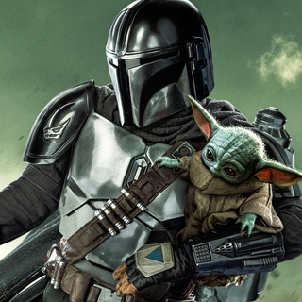


Mandalorian
Unreal Engine Sets
Microsoft HoloLens
AR Training
VR Games
Simulation

Slide 11
The Games Industry
Entertainment
Education
Business
Projected at $334B in 2023
$11.24B Market
Simulation training solutions.

Slide 12
03
Game Development
fundamentals

Slide 13
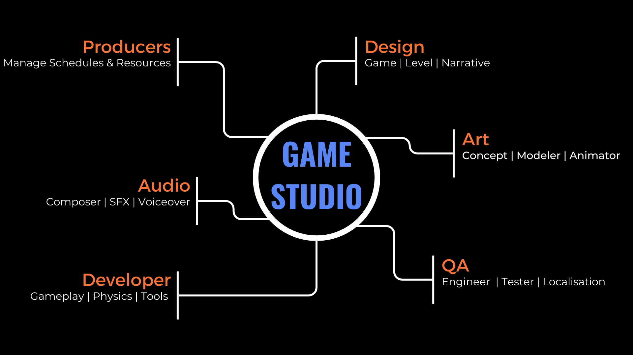
Notes:
Director: Sets creative vision, guides development.
Producer: Manages project, schedules, and resources.
Designer: Shapes gameplay, mechanics, and user experience.
Developer: Codes and builds game mechanics.
QA Tester: Identifies and reports bugs, ensures quality.
Marketing: Promotes game, engages players, boosts sales.
Artists: Create visual assets.

Slide 14
The Life Cycle
Concept
Development
Design
Release

Slide 15
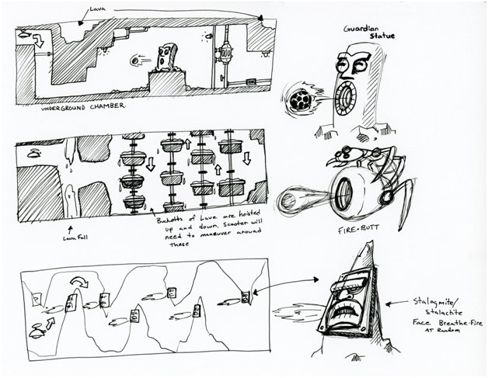
1.Concept
Initial idea and brainstorming by directors
Defining the game’s theme, genre and core mechanics
Create a clear vision of what the product will look like and how players will interact with it.

Slide 16
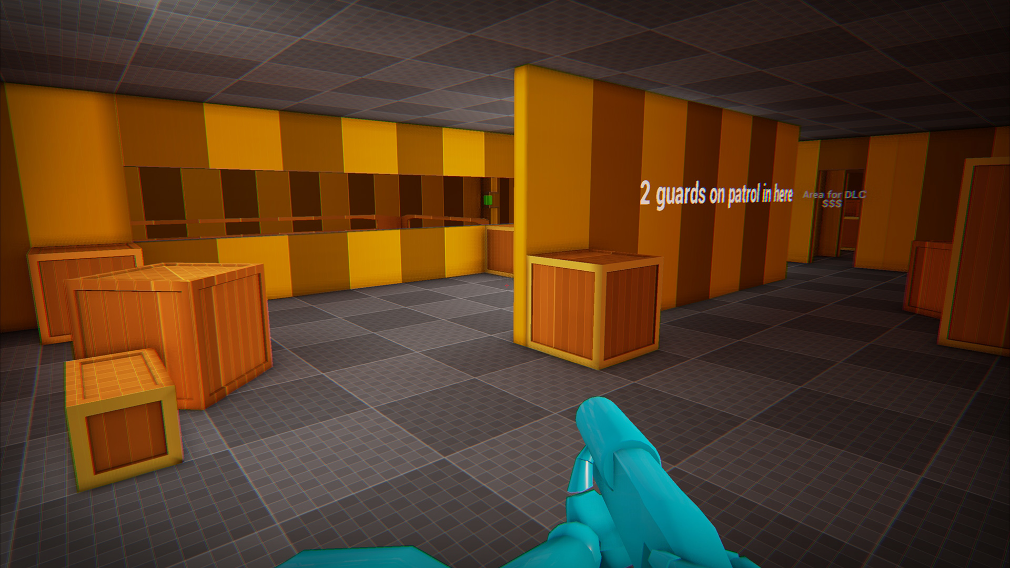
2.Design
Designers begin planning out all aspects of the game in detail.
Initial concepts and designs for levels, characters and gameplay.
Story elements, UI and game progression are defined
Technical deliberate on the tech and platform.
Cost & Time is estimated.

Slide 17
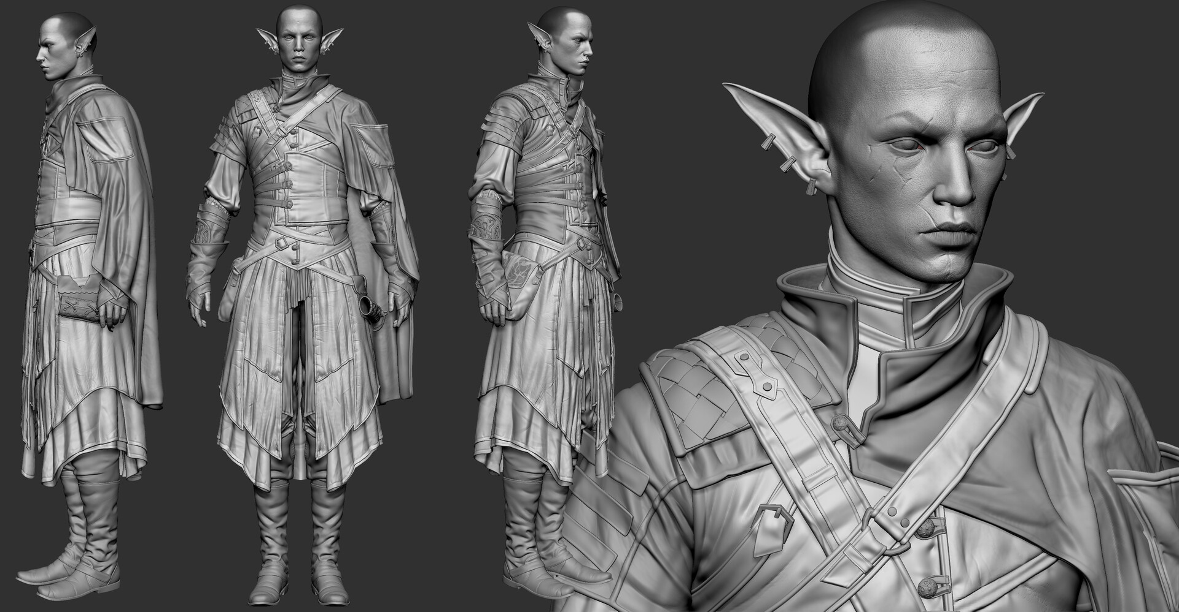
3.Development
Most of the team is now working on the project
Programmers are adding functionality
Artists are creating visual assets
Sound engineers compuse music and sound effects.

Slide 18
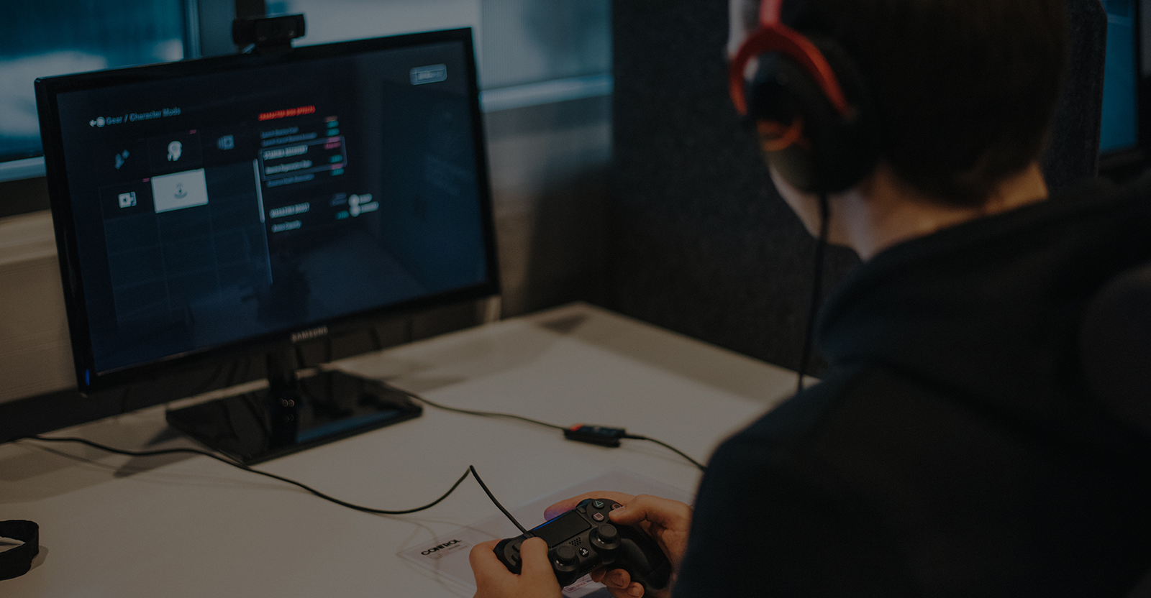
4.Playtesting
Quality assurance testers play through the game to identify bugs, glitches, and gameplay issues.
Feedback from testers helps developers refine the game and improve the player experience.

Slide 19
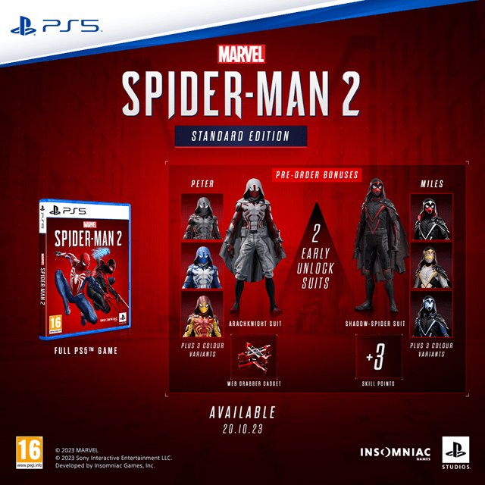
5.Polish & Release
Developers address any issues identified during testing, optimizing performance and gameplay.
Visuals, animations, and audio are fine-tuned
Marketing & Distribution in full swing

Slide 20
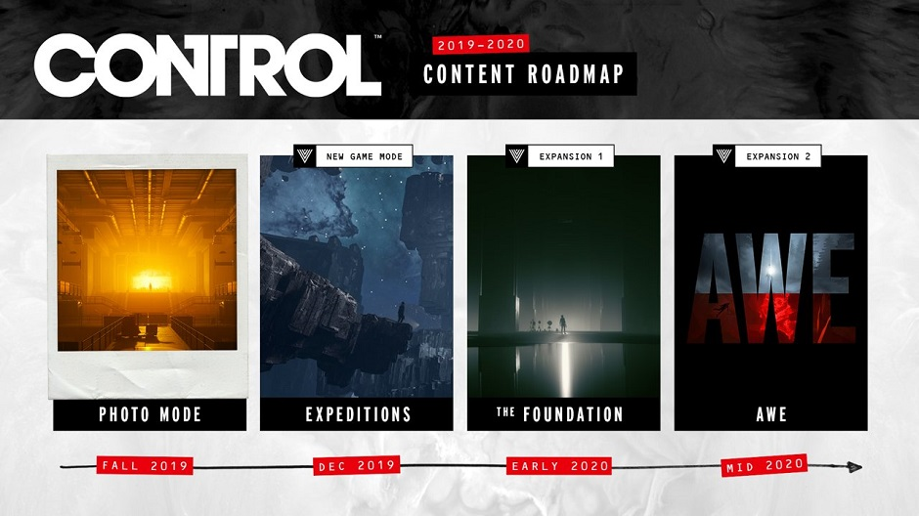
6.Post Release
patches, updates, and downloadable content (DLC)
Player feedback

Slide 21
04
Game Design

Slide 22

Game Design
Process of shaping the visuals, mechanics and rules of a game all in an effort to make the most engaging experience

Slide 23

Gameplay
How does the player interact with the world.
How does the player move, explore, solve challenges and make decisions
Provides a sense of agency and accomplishment
Difficulty can be managed to increase engagement

Slide 24
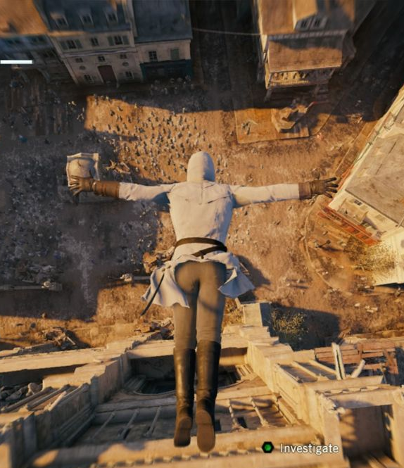
Mechanics
Encompass the rules, systems and interactions
They present challenges as well as the opportunities for the player to use.
Thoughtfully designed mechanics keep players engaged as they seek to master them and strategise

Slide 25
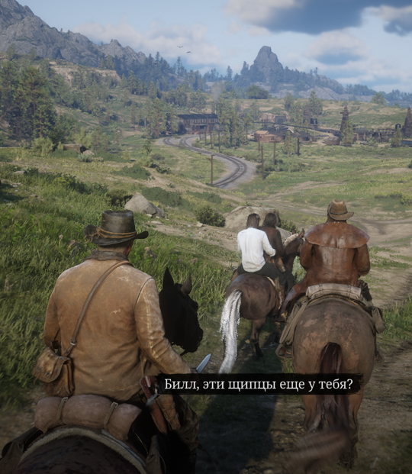
Story
Provides emotional depth and motivation
Enhances the setting & atmosphere
Creates a sense of immersion
Allows for meaningful decisions

Slide 26
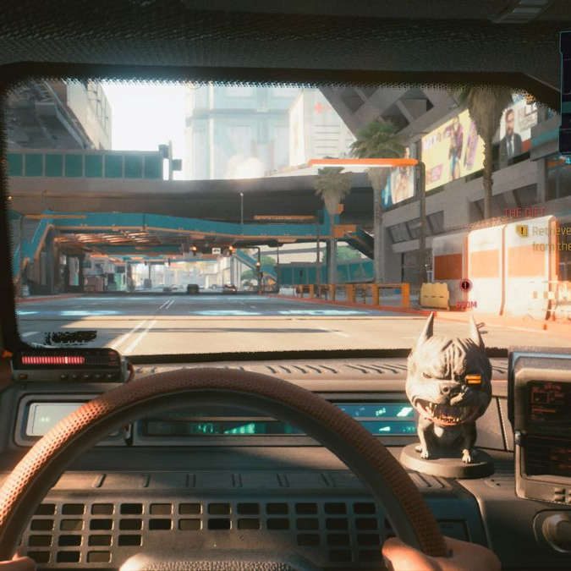
Graphics
Anything that is visible on screen
Artistic choices give the game an identity
Visual consistency helps with immersion
Visuals have to be balanced with performance.

Slide 27

Notes:
Ambience
Cues
Voiceovers
Music

Slide 28
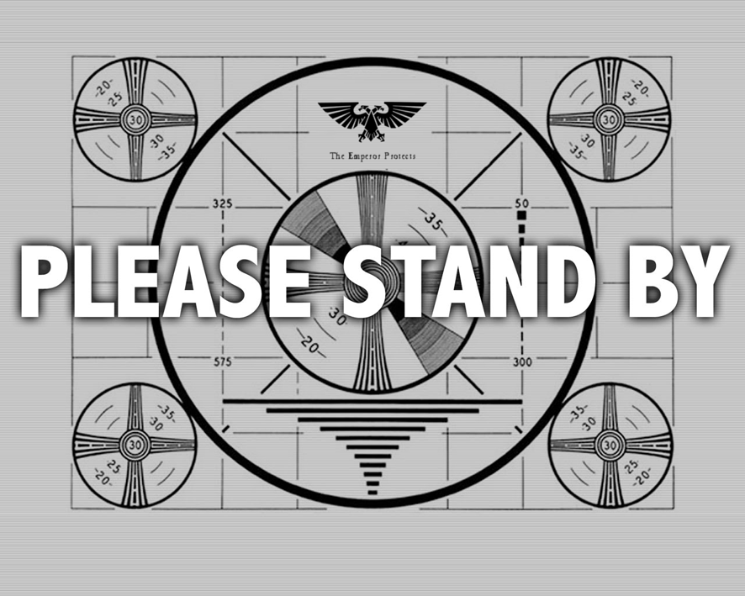

Slide 29
04
Major Project

Slide 30
Requirements
Mobile Game
Game Loop
Polished
Commercial
Unity-made, hyper-casual game.
Fully functional game loop.
No major/game breaking bugs.
All assets should be properly licensed.

Slide 31

Resources

